Slide 1

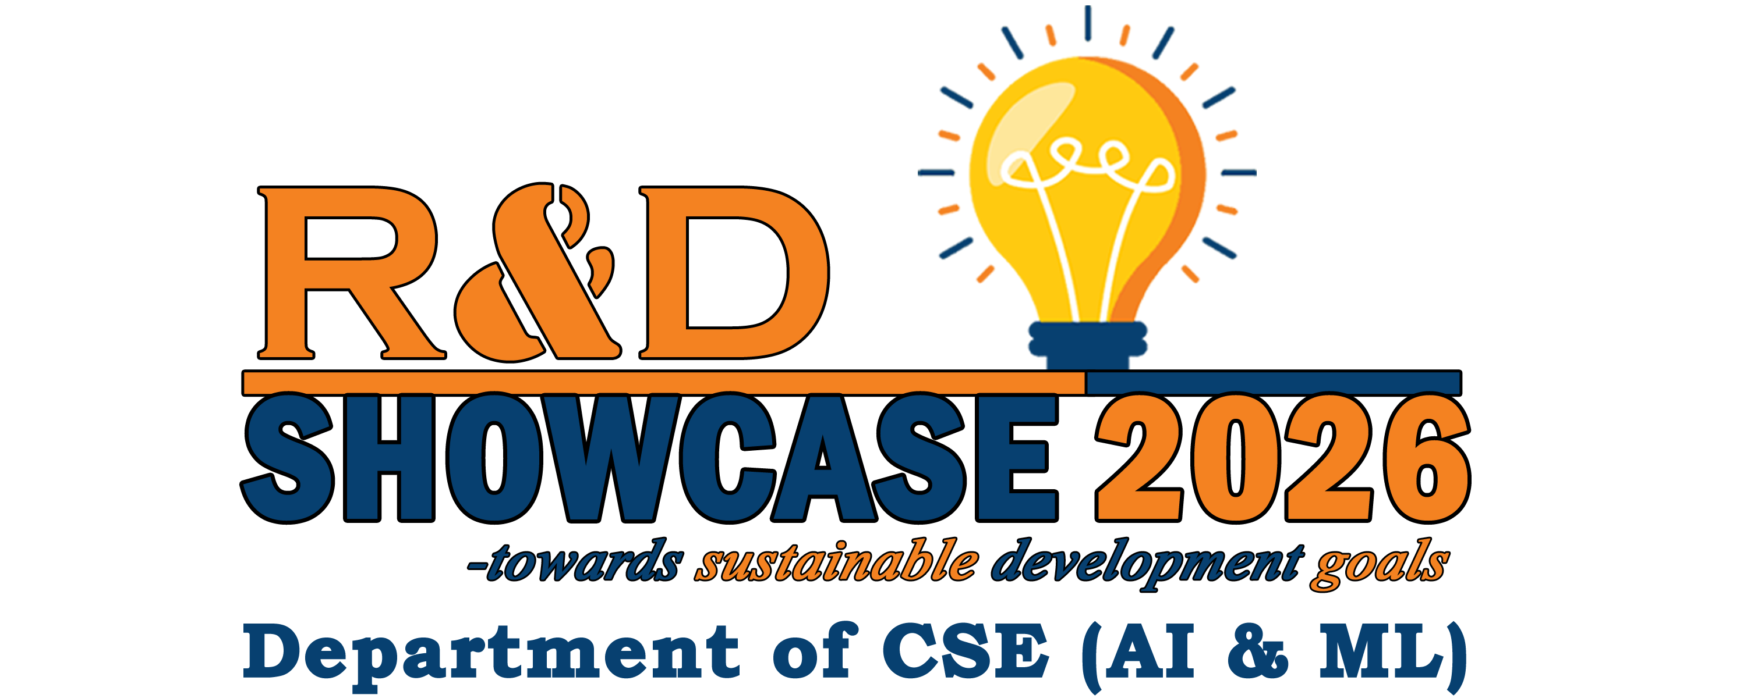

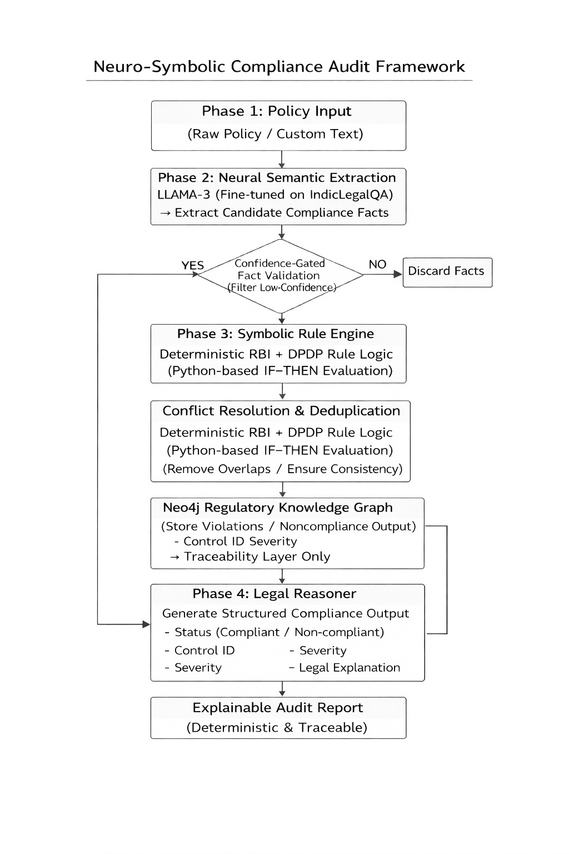
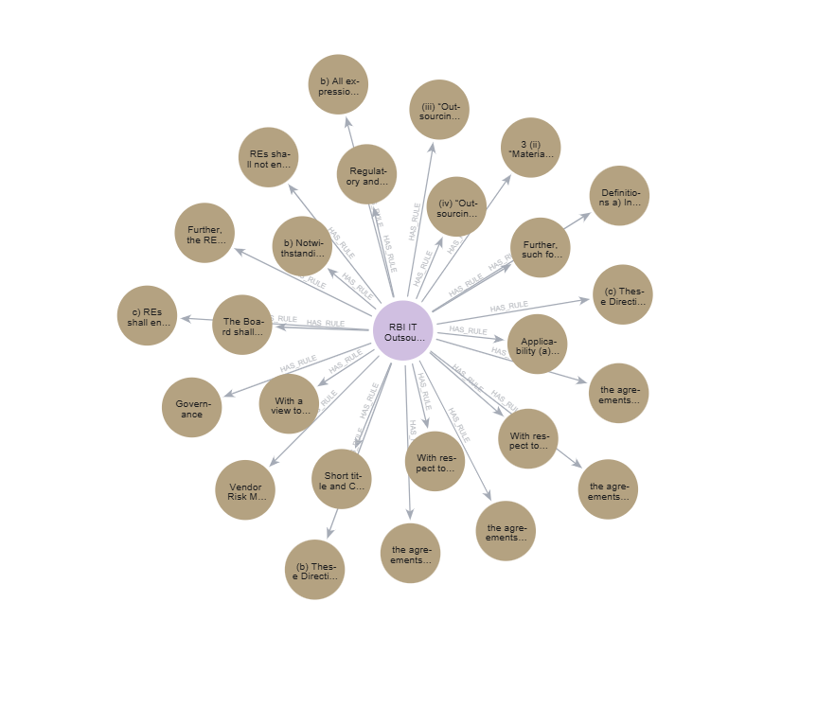
B V RAJU INSTITUTE OF TECHNOLOGY
(UGC Autonomous , Affiliated to JNTUH, Approved by AICTE, Accredited by NBA and NAAC)
Vishnupur, Narsapur, Telangana – 502313
Department of CSE (Artificial Intelligence and Machine Learning)
AUDITFLOW AI: AN NLP BASED REGULATORY INTERPRETATION AND POLICY GAP DETECTION
P.Sri Bhuvan, U.Sreeja, V.Vaishnavi, Supervisor: Mrs. M Mounika - Co-Supervisor: Ms. B Divyasri
Introduction
dataset to improve Indian legal understanding.
3. Neural Semantic Extraction:
Utilized Llama-3 to extract structured obligations, entities, conditions, and exceptions from unstructured regulatory documents.
4. Confidence-Gated Validation:
Implemented threshold-based filtering to eliminate low-confidence or hallucinated facts before symbolic reasoning.
5. Regulatory Knowledge Graph Construction (Neo4j RKG):
Built a structured graph encoding statutes, clauses, regulatory hierarchy, and inter-law dependencies using Neo4j.
High Precision (0.93) demonstrates reliability in identifying legally valid violations.
Very Low Hallucination Rate (0.01) confirms effectiveness of logic-first architecture.
Deterministic Outputs (97% consistency) ensure reproducible compliance decisions.
Lower recall (0.56) reflects conservative Closed-World Assumption, prioritizing legal defensibility over aggressive detection.
Compared to RAG-based systems, AuditFlow AI shows superior stability and legal reasoning capability.
AuditFlow AI is a Neuro-Symbolic Regulatory Compliance System that evaluates banking policies against RBI IT Outsourcing Guidelines and the DPDP Act, 2023.
It separates LLM-based understanding from deterministic symbolic rule enforcement, ensuring legally grounded and reproducible decisions.
By combining structured fact extraction with a knowledge-graph-backed rule engine, the system delivers transparent, explainable, and audit-ready compliance outputs while minimizing hallucinations.
Conclusion
Objectives
AuditFlow AI presents a Type-6 Neuro-Symbolic Compliance Framework combining neural semantic extraction with deterministic symbolic reasoning. By separating perception (Llama-3) from validation (Neo4j RKG), the system achieves high precision, minimal hallucination, and clause-level traceability.
The architecture ensures legally grounded, auditable, and reproducible compliance assessments, making it suitable for high-stakes regulatory environments such as Indian banking and financial governance.
Develop a Neuro-Symbolic Regulatory Compliance Framework that integrates neural language understanding with deterministic symbolic reasoning for Indian financial regulations.
Design a Regulatory Knowledge Graph (RKG) using Neo4j to enable structured encoding of DPDP Act and RBI Master Directions with hierarchical conflict resolution.
Achieve high-precision, low-hallucination compliance auditing with clause-level traceability and reproducible decision-making.
Results & Discussion
References
Table 1: Quantitative Results
Wu, X., et al. (2024). Knowledge-infused legal wisdom: Navigating LLM consultation through the lens of diagnostics and reinforcement learning. ACL.
Yao, Z., et al. (2025). Elevating legal LLM responses: Harnessing trainable logical structures and semantic knowledge with legal reasoning. NAACL.
Carter, R., et al. (2025). Neuro-symbolic AI for real-time anti-money laundering systems. ResearchGate.
Hsia, Y., et al. (2025). Neuro-symbolic compliance: Integrating LLMs and SMT for automated financial legal analysis. AIware.
Figure 1: Visualization of Knowledge graph
Metric | Value
Accuracy | 81.2%
Precision | 93.1%
Recall | 56.6%
F1-Score | 70.4%
Hallucination Rate | 1%
Traceability Coverage | 98%
Logical Consistency | 97%
Methodology
6. Deterministic Symbolic Reasoning & Conflict Resolution:
Applied Cypher-based rule evaluation to resolve overlaps between DPDP and RBI mandates using priority-based statutory hierarchy.
7. Explainable Audit Report Generation:
Generated clause-level traceability outputs mapping each compliance verdict to specific statutory provisions and control identifiers.
1. Regulatory Data Ingestion:
Collected statutory documents including DPDP Act (2023), RBI Master Directions, Gazette notifications, and internal banking policies.
2. IndicLegalQA Fine-Tuning:
Adapted Llama-3 using IndicLegalQA
Team No: 23C-114
Domain: S & NLP
SDGs: 8, 9, 16

